Slide 1



Wigner Molecule in a Quantum Disk: Uncertainty Principle Versus Moshinsky's Model
Aram Nahapetyan
In collaboration with D.A. Baghdasaryan, V.A. Harutyunyan, H.A. Sarkisyan
Dilijan 2026

Slide 2
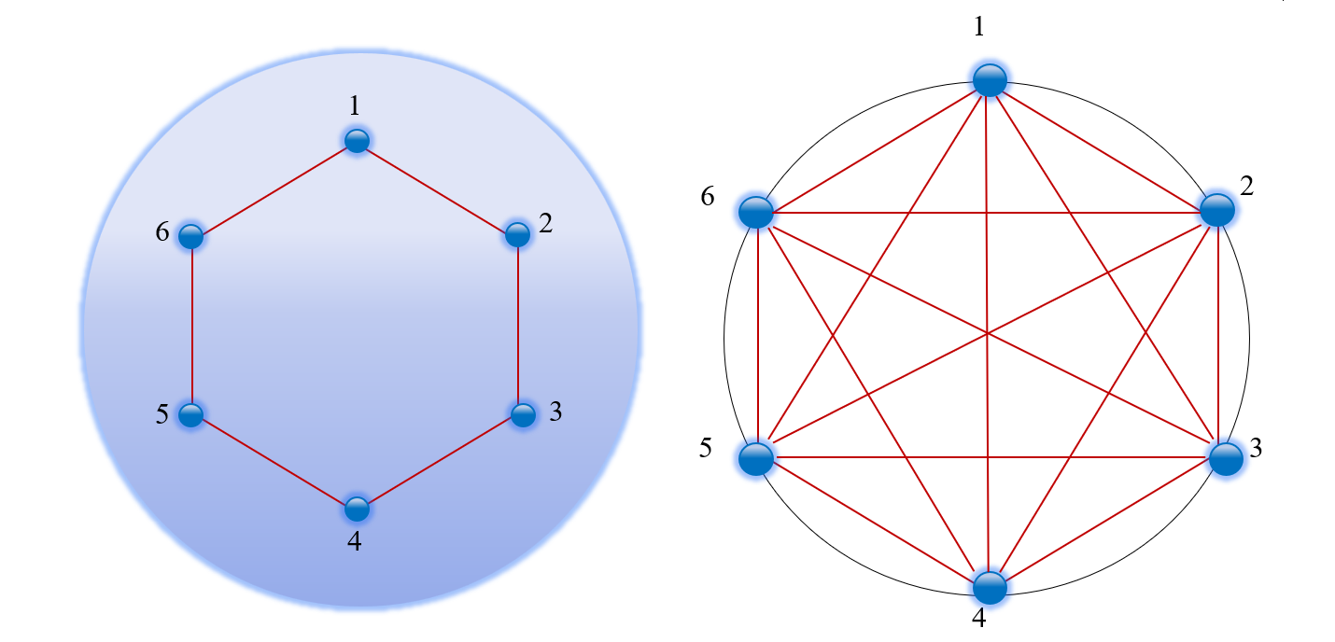
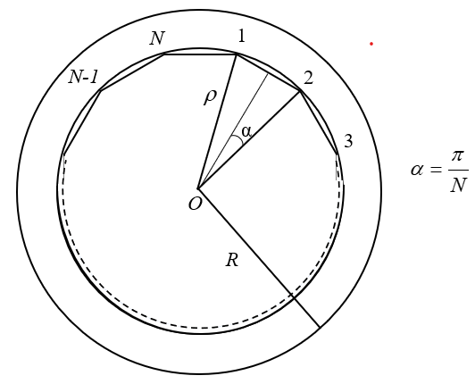
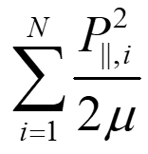
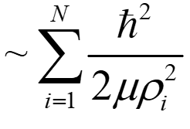

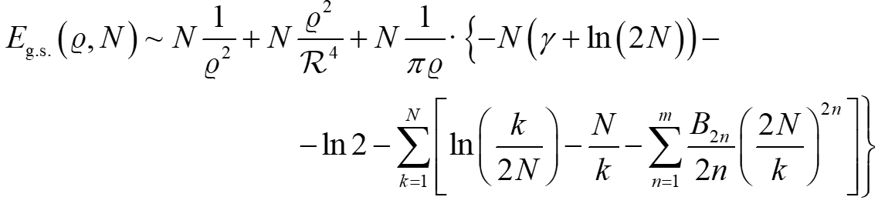
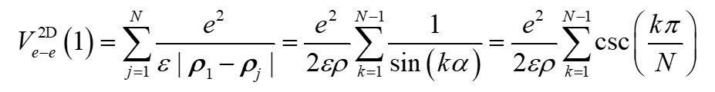
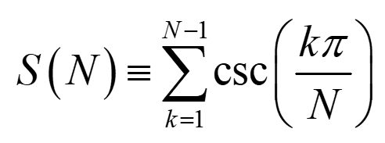
Wigner molecule
in a Quasi 2D quantum disk: Coulomb Interaction
- Watson’s trigonometric sum

Slide 3
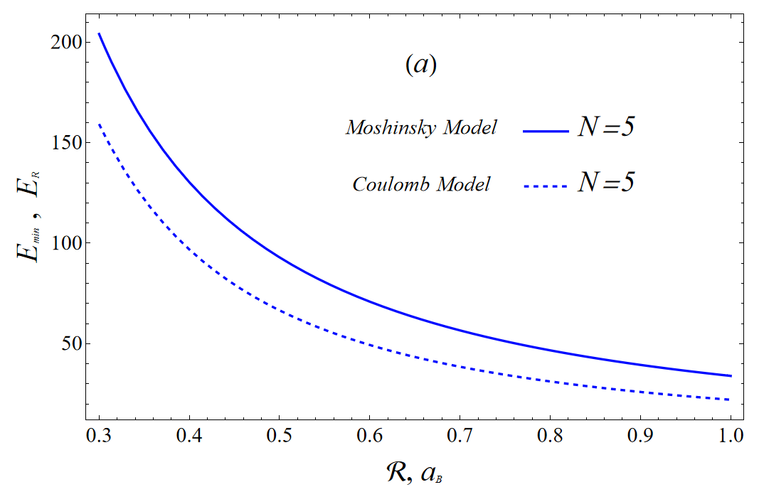
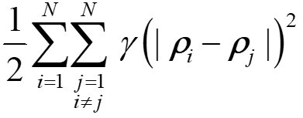
Wigner molecule
in a Quasi 2D quantum disk: Moshinsky Model
The comparison of energy dependences on the disk radius obtained using Moshinsky and Coulomb models
for interparticle potential for the number of particles in the system equal to (a)

Slide 4


